Slide 1
Becoming Fluent in Data (2022)
Setup

Slide 2



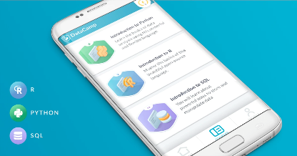
Software
The course uses different software components for learning.
Statistical Software
Integrated Development Environment
Version Control & file sharing
Cloud storage
Assignments & Discussion
Datacamp
(Learning Platform)
Datacamp Mobile
*All work on either Mac or Windows operation system.

Slide 3

Setup
Steps to complete.
Step 1. Install MS Teams.
Step 2. Install R.
Step 3. Install RStudio.
Step 4. Install git.
Step 5. Connect RStudio to Github.
* If you have completed this setup and can run code …you’re off to a great start! And don’t worry if you hit a hiccup, we will figure it out.

Slide 4
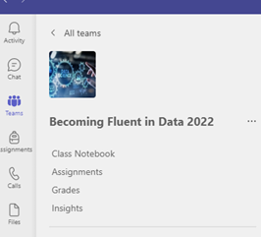
Step 1. Install MS Teams
Microsoft Teams: Office 365 Education
Register Office 365 education with your student E-Mail:
https://www.microsoft.com/de-de/education/products/office
Use Team Link:
https://teams.microsoft.com/l/team/19%3aBL5KRIQ2fKd248VCfkT5xCpa33P_QmTvl_zQWd5YnbE1%40thread.tacv2/conversations?groupId=7eae0536-0949-4fed-b6dc-3c89aac103df&tenantId=41360a17-9216-4d8b-bc2d-26b7cc95fe99

Slide 5
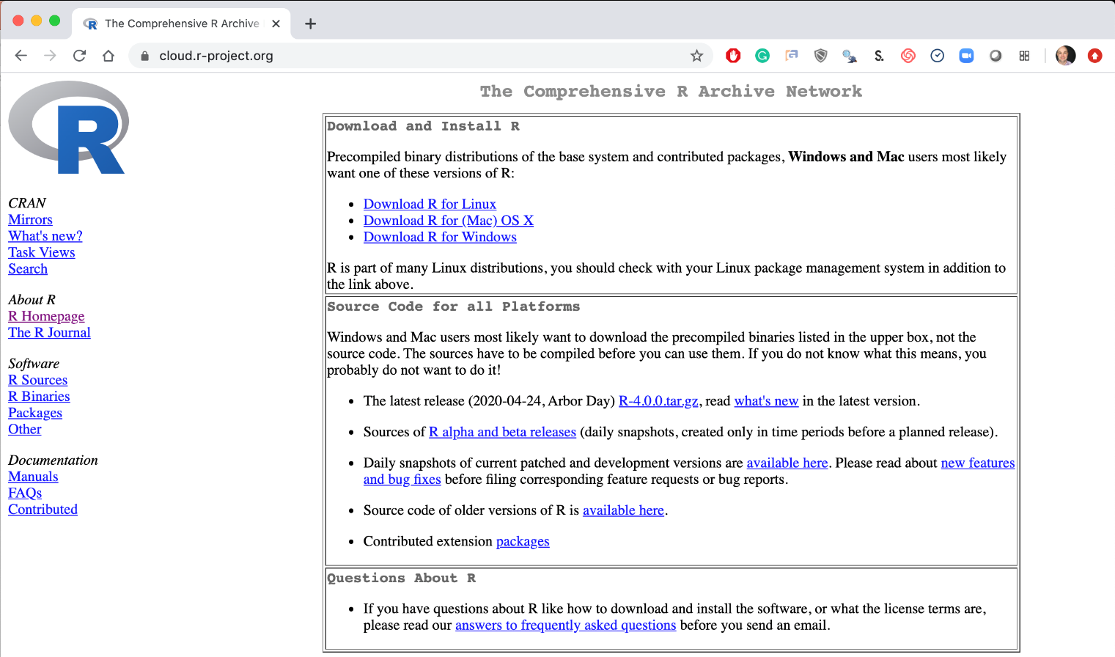
Step 2. Install Base -R
Local Laptop – Windows or Mac
Download the appropriate version Linux, Mac or Windows.
https://cloud.r-project.org/

Slide 6
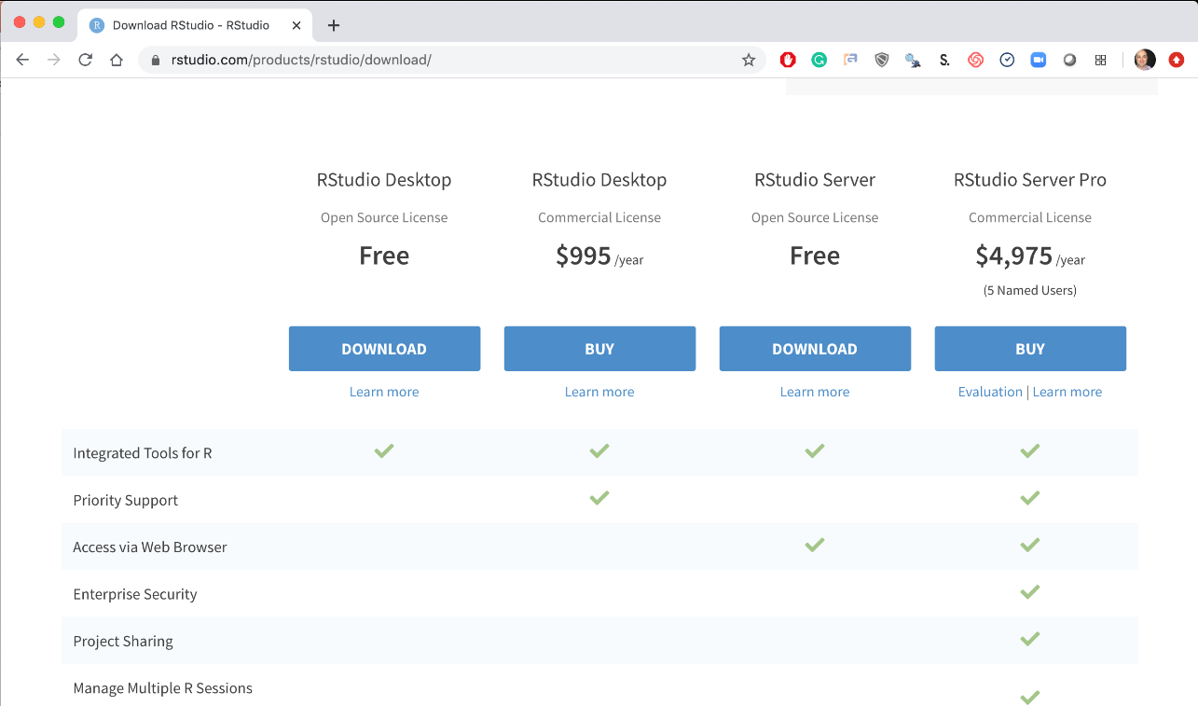
Step 3. Install RStudio
Local Laptop – Windows or Mac
Download the RStudio Desktop (Free)
https://rstudio.com/products/rstudio/download/
https://rstudio.com/products/rstudio/download/#download

Slide 7
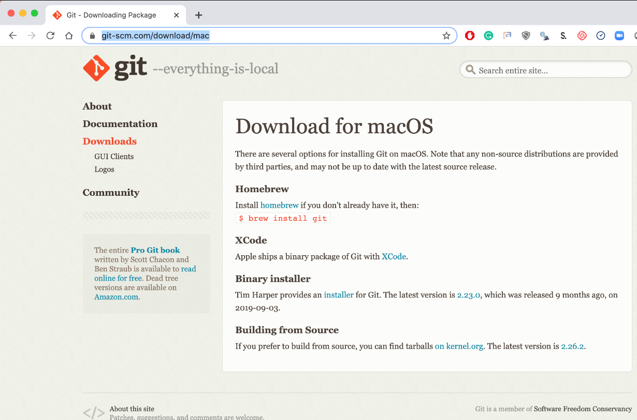
Step 4. Install Git (Mac)
Local Laptop – Mac
Download the Git Program, then follow prompts for installation.
https://git-scm.com/download/mac
https://www.youtube.com/watch?v=twFo9wCpdSU

Slide 8
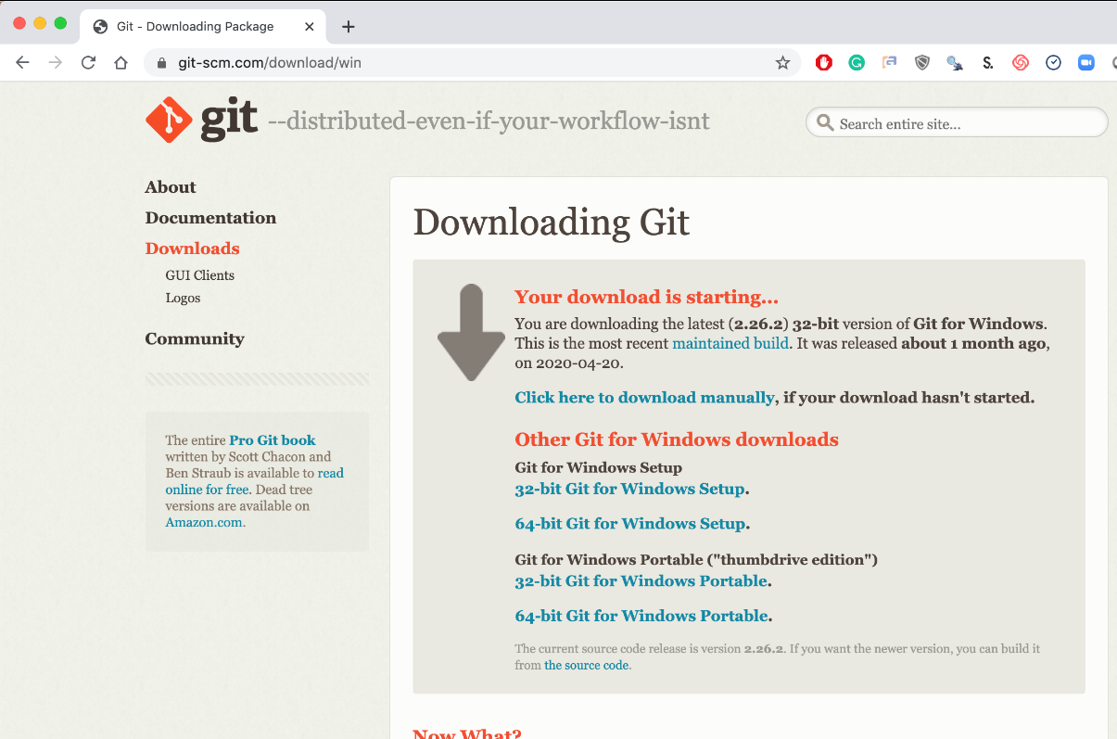
Step 4. Install Git (Windows)
Local Laptop – Windows
Download the Git Program, then follow prompts for installation.
https://git-scm.com/download/win
https://www.youtube.com/watch?v=nbFwejIsHlY

Slide 9
Magic
You should now have R, R-Studio and git.

Slide 10
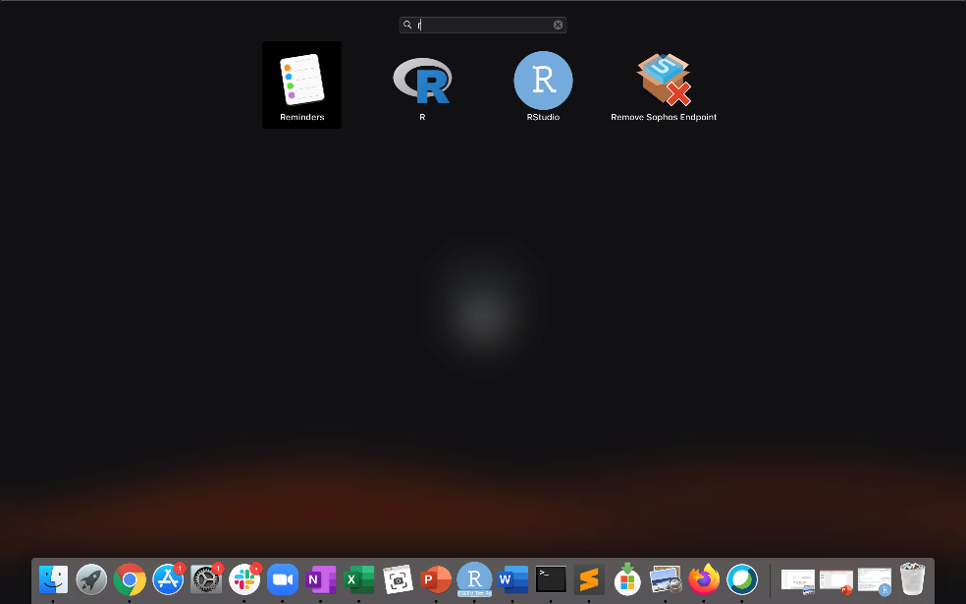
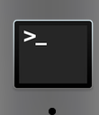
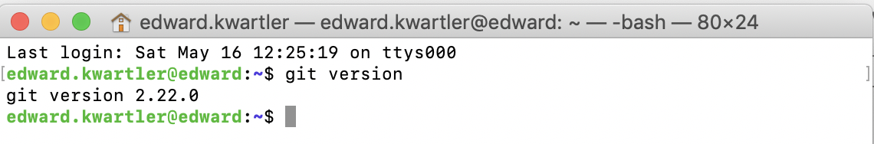
All good?
Mac: Use “Launchpad” & Type R
Mac: Use: “Terminal” & Type “git version”
Mac: Look for R and RStudio Icons.

Slide 11
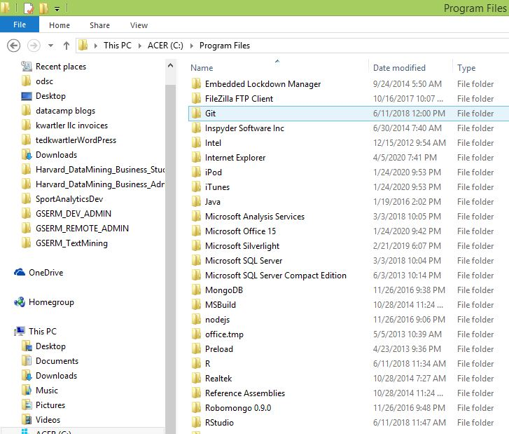
All good?
Windows: Navigate to the program folder look for git, R and RStudio

Slide 12
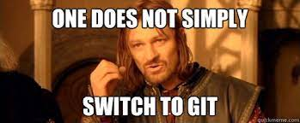
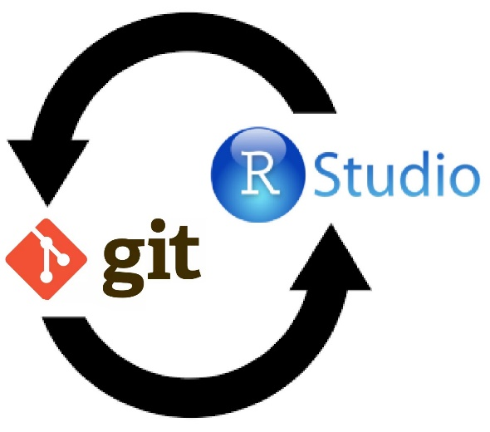
You should now have R, R-Studio and git.

Slide 13
Step 5. Connect Rstudio to Repo.
Now that you have R, R-Studio & git, time to connect to our class repository.
Connect to git repository.
R Studio sits on top of base R & adds functionality.
Class Files hosted on github.com
Makes the programmatic connection.
*Think of GitHub as a dropbox for programmer.

Slide 14
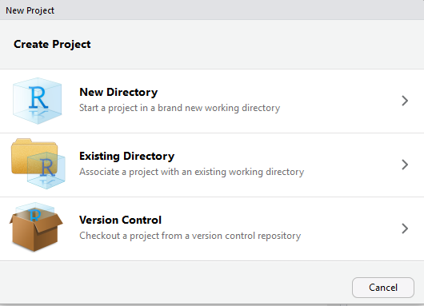
Step 5. Setup a new project & do a “git pull”
For you to look at in browser: https://github.com/MarcoKuehne/seminars_in_applied_economics
Enter in your Rstudio Instance:
https://github.com/MarcoKuehne/seminars_in_applied_economics.git
Open RStudio
File
New Project
Version Control

Slide 15
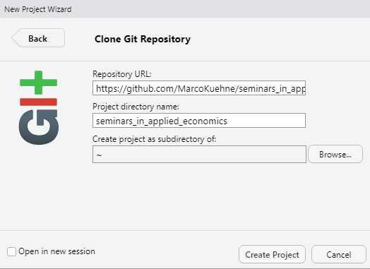

Step 5. Setup a new project & do a “git pull”
In RStudio
File
New Project…
Version Control
Select Git
Add URL, folder name & destination for files
Appears by magic
https://github.com/MarcoKuehne/seminars_in_applied_economics.git

Slide 16
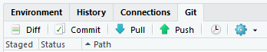
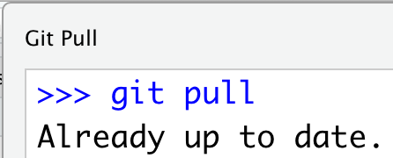
Each day we will perform a “git pull” in case there are updates to curriculum to aid learning.
In RStudio
File
New Project…
Version Control
Select Git
Add URL, folder name & destination for files
EACH Class session perform a Git Pull to update files

Slide 17
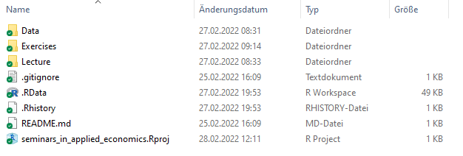
One folder, all data.
Somewhere in your favorite destination you now synchronized all course material
(data, homework, lectures, etc.).
Everytime you start to work, click this project file “.Rproj”
EACH Class session perform a Git Pull to update files

Slide 18


One folder, all data.
Again. Start “.Rproj”. Do “git pull”. Awesome.
Workflow (git yourself a coffee)
Click project file “seminars_in_applied_economics .Rproj”
Go right upper panel, Git tab, Pull botton
Enjoy

Slide 19
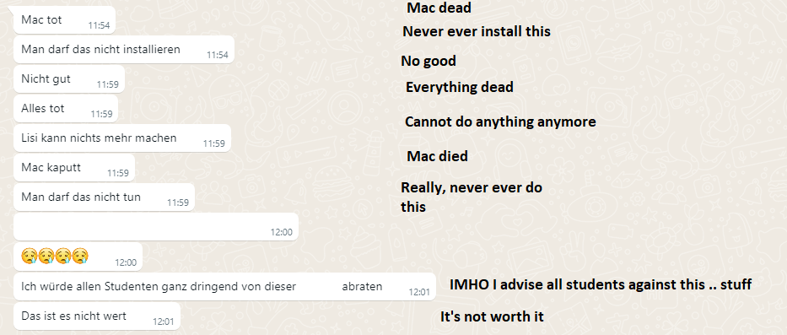

True stories …

Slide 20
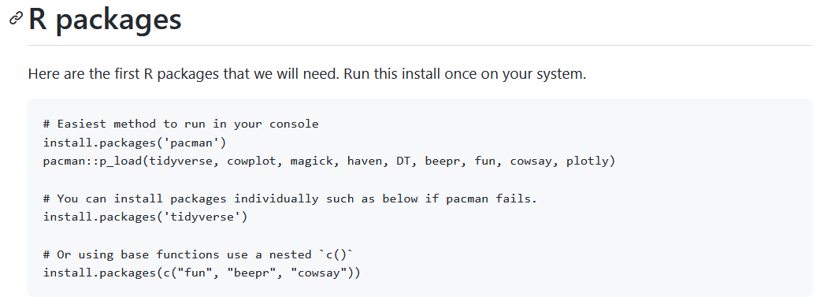
Now just run some code (we will explain it later)
https://github.com/MarcoKuehne/seminars_in_applied_economics has the R code.
install.packages('pacman’)
pacman::p_load(tidyverse, cowplot, magick, haven, DT, beepr, fun, cowsay, plotly)

Slide 21
Last item. Create a personal folder.
Why?
Create a personal folder inside the R project.
“Git pull” downloads all new changes from the Github repository.
There is a “Git push” button that you cannot use.
The Github repo is public but read-only.
Create a personal folder that is ignored by git.
This is were you can work on scripts and homework.

Slide 22
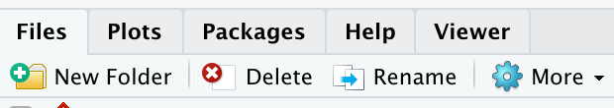
Last item. Create a personal folder.
In the lower right file section click “New Folder”. Name it “personal” exactly as in the gitignore (capitalization)
You can create folders from inside Rstudio.
Click New Folder

Slide 23
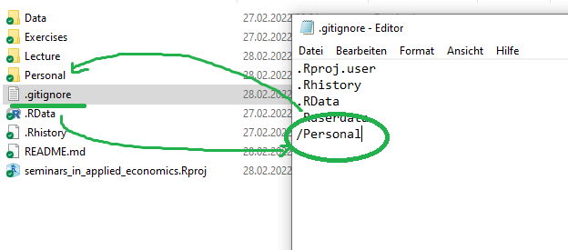
Last item. Create a personal folder.
Open the “gitignore” file. Add slash personal
Name of folder to be ignored “Personal”
When you work and make changes to scripts, SAVE AS to a personal folder that is ignored by git.

Slide 24
Almost setup…don’t worry if you need help live.

